Slide 1
SI -4 M&M IndustrialAutomation
Module 2 Structured Text

Slide 2
This Module:
Introduction IEC 6-1131-3 Languages.
Structured Text - ST
.
.
.

Slide 3






Introduction IEC 6-1131-3 Languages
The standard, which is currently followed to a greater or lesser degree by most of the major PLC manufacturers, includes various programming languages:
Structured Text – ST (textual)
Function Block Diagram – FBD ( graphical)
Ladder Diagram – LD (graphical)
Instruction List – IL (textual)
Sequential Function Chart – SFC ( graphical)

Slide 4
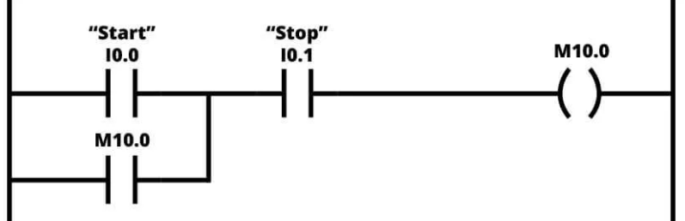
Structured Text vs Ladder Diagram
Motor
IF (Start OR M10.0) AND NOT Stop THEN
Motor := TRUE;
ELSE
Motor := FALSE;
END_IF
Motor := (Start OR M10.0) AND NOT Stop;

Slide 5
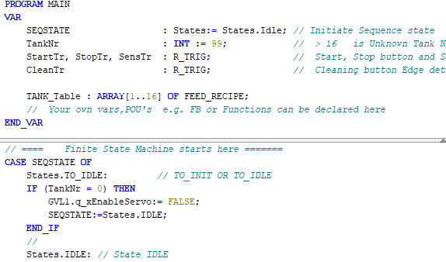
Structured Text
Why Structured Text ?
Text –Based.
Standard.
Scalable and Powerful.
Version Control Compatible.
Notes:
Why structured Text ?
Scalable – Powerful = Developed to program complex arithmetic functions, manipulate tables, and work with
word objects and text.
Conditional instructions, the declaration of a variable, state machines sequences,
OOP possibilities: supports UML class diagram, state diagram

Slide 6
Structured Text
// Expressions are constructs that return a value( note “;”)
Variable1 + Variable2 ;
MotorSpeed * ElapsedTime + OffSet;
// Assignments assign a value to a variable using “:=“
FinalResult := Variable1 + Variable2 ;
Totaldistance := MotorSpeed * ElapsedTime + OffSet;

Slide 7
Structured Text
//Comments
// Single line comment uses “//”
(*
Multi-line comments or block comments
use “(* … *)”
*)
// Boolean Operations work on the binary level
Toggle := NOT Toggle; //Inverse
MyResult := varB OR varC ;
Var1 := 2#0110_1100;
Var2 := NOT Var1;
Var3 := NOT 2#1010_1010;

Slide 8
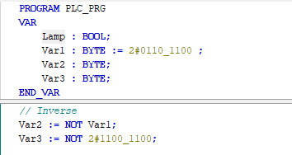
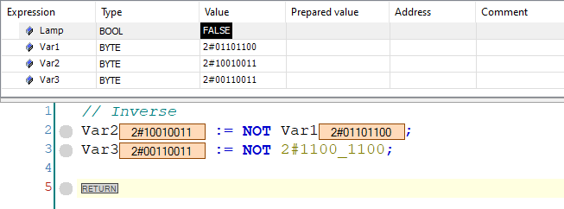
Structured Text
Example Online Monitoring

Slide 9
Structured Text
//Arithmetic Operations
// Arithmetic Operations are completed with “+”, “-”, “/”, “*” or “MOD”
MyResult := varB + varC ;
ScaledResult := varA * (varB + varC) ;
Var2 := varB - varC;
IF statements use a structure of IF … THEN … ELSE / ELSEIF … END_IF
IF ( A > B ) THEN
C:= A – B ;
ELSE
C:= A ;
END_IF
Notes:
Same rules as in the real world math

Slide 10
Structured Text
//FOR Loop
// Loop FOR a limited number of repetitions using a
FOR … TO … BY … DO … END_FOR structure
FOR i:= 0 TO 100 BY Step DO
MyArray[i] := Num[i] + varB ;
END_FOR
//While Loop
The WHILE loop is used like the FOR loop in order to execute instructions several times until the abort condition occurs.
The abort condition of a WHILE loop is a boolean expression.
WHILE iCounter <> 0 DO
iCounter := iCounter - 1 ;
varA := varA + varB ;
END_WHILE

Slide 11

//Function Blocks
//A function block is a POU that supplies one or more values during execution
Structured Text
VAR
MyDelayON : TON; // Instance of Function Block TON
END_VAR // See also TOF and TP
// Call FUBs in-line
MyDelayON(IN := Button,
PT := T#1M2S,
Q => boolResult,
ET => RemainingTime);
// ....or separately
MyDelayON.IN := Button ;
MyDelayON.PT := T#1M2S;
MyDelayON();
qLight := MyDelayON.Q;
timeElapsed := MyDelayON.ET;
Notes:
You always call a function block via an instance, that is a copy of the function block

Slide 12
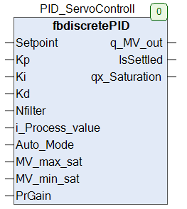
Structured Text
//A function FB call example.
VAR
PID_XServoControl : fbdiscretePID;
//
//
END_VAR
PID_XServoControl.Auto_Mode := TRUE;
PID_XServoControl.Kp:= 1.8; //
PID_XServoControl.Ki:= 0.0;
PID_XServoControl.Kd:= 0.0;
PID_XServoControl.MV_max_sat:= 10;
PID_XServoControl.MV_min_sat:= -10;
PID_XServoControl.PrGain:= 10;
// Executing the PID COntroller
PID_XServoControl(i_Process_value:= SERVO_XPOS2.Yout,
q_MV_out => SERVO_XPOS2.Xin,
qx_Saturation=> SaturationWarning);

Slide 13
Structured Text
// Functions.
// A function is a POU that supplies precisely one data element when executed and: whose call in a textual languages can occur as an operator in expressions. The data element can also be an array or a structure
FUNCTION SUMMATION : INT;
VAR_INPUT
ivarA, ivarB, ivarC :INT;
END_VAR
VAR
// other variables
END_VAR
SUMMATION := ivarA + ivarB + ivarC;
// Functions.
// A function call in Structured text:
Result := SUMMATION(varA,varB,varC);

Slide 14
// CASE Statement
// State machines are used regularly, especially in automation technology.
// following an example
VAR
ProcessTime : TON;
//
END_VAR
ProcessTime(in:=StartTimer);
CASE iVar OF
1,5:
bVar1 := TRUE;
6:
bVar2 := FALSE;
bVar3 := TRUE;
StartTimer:= TRUE;
ProcessTime.PT := T#10S;
IF ProcessTime.Q THEN
StartTimer:= FALSE;
iVar := 11;
END_IF
10..20:
bVar1 := TRUE;
ELSE
bVar1 := NOT bVar1;
bVar2 := bVar1 OR bVar2;
END_CASE

Slide 15
Structured Text
This course is mainly research based. There are abundance of information about CODESYS and Structured Text on YouTube.
END of PRESENTATION
Questions ?

